Slide 1
Netflix Movies Recommendation System And EDA
BY :- Sagar Dixit
CLIENT :- Iclivia
DATE :- 6/03/2025

Slide 2
Tasks ● Developing a content-based recommender system using the genres and/or descriptions. ● Identifying the main content available on the streaming. ● Network analysis on the cast of the titles. ● Exploratory data analysis to find interesting insights.

Slide 3
Question you have to finish : Exploratory Data Analysis (EDA) & Insights 1. Can we predict the IMDB score of a title based on its features (genre, release year, runtime, etc.)? 2. What factors contribute the most to a title’s popularity on TMDB? 3. How does the number of seasons in a TV show correlate with its IMDB rating and popularity? Classification Problems 4. Can we classify whether a title is a movie or TV show based on its metadata? 5. Can we predict the age certification of a title based on its description, runtime, and genres? 6. Given a title's details, can we classify whether it is successful or unsuccessful (IMDB score above a threshold)? Regression Problems 7. Can we predict the IMDB votes a title will receive based on its features? 8. Can we estimate the popularity score on TMDB for a given title before its release? 9. How accurately can we predict the IMDB score of a new title? Recommendation & Clustering 10. Can we cluster Netflix titles into groups based on similar genres and popularity?

Slide 4
11. Can we build a content-based recommendation system using the dataset (e.g., recommend similar titles based on description and genre)?
12. Can we use natural language processing (NLP) to analyze descriptions and cluster similar movies/shows?
Time Series & Trend Analysis
13. Can we use ARIMA/SARIMA to forecast Netflix content release trends over time?
14. How has the distribution of movie genres changed over the years?
15. Does the number of Netflix releases show a seasonal pattern?
Data Exploration & Visualization
16. What are the most common genres on Netflix?
17. Which production countries dominate Netflix content?
18. What is the relationship between IMDb scores and TMDB popularity?

Slide 5
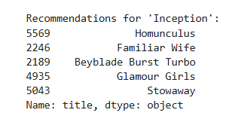
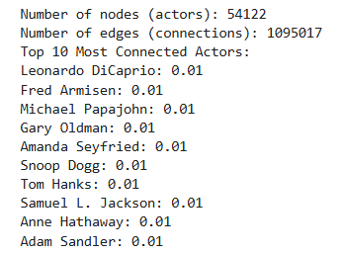
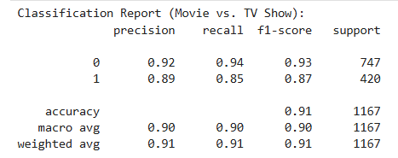
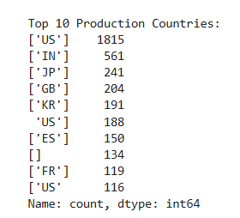
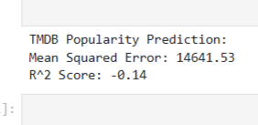
Result Of the System:

Slide 6
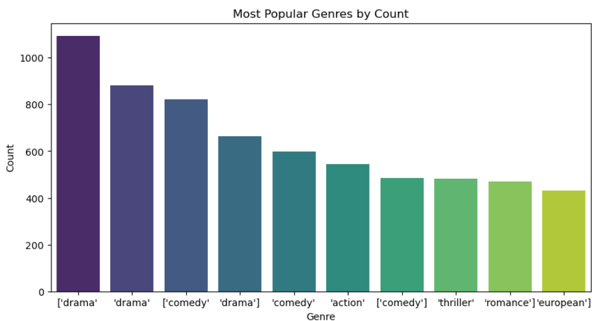
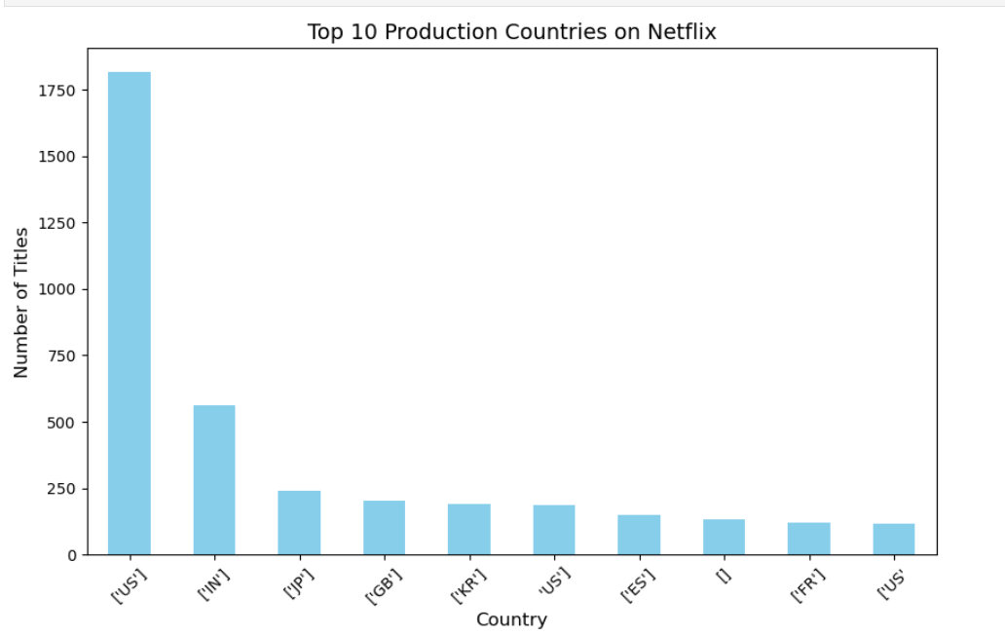
EDA:

Slide 7
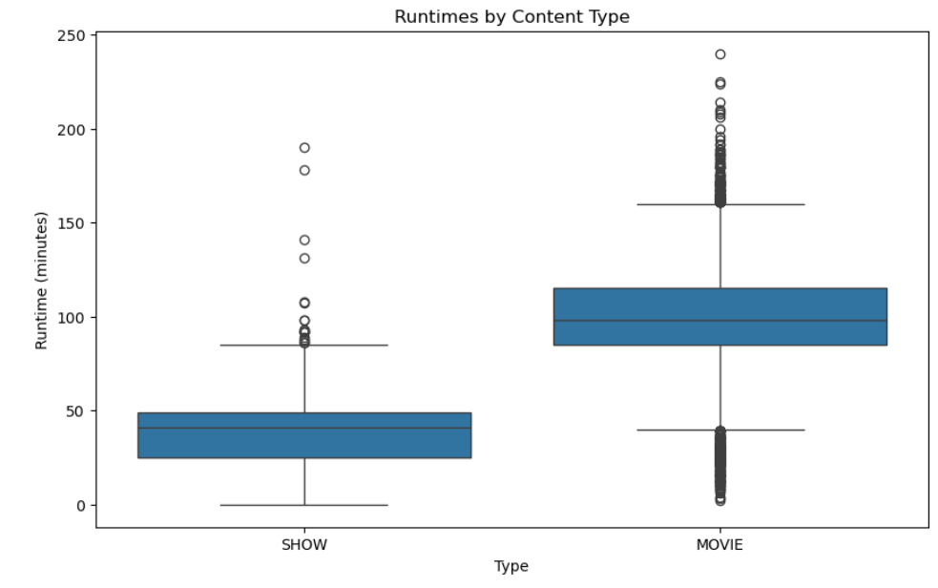
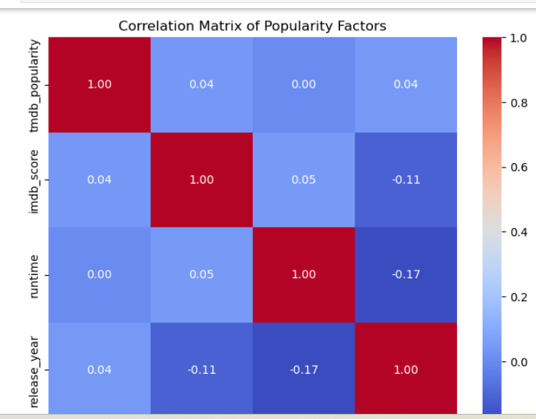

Slide 8
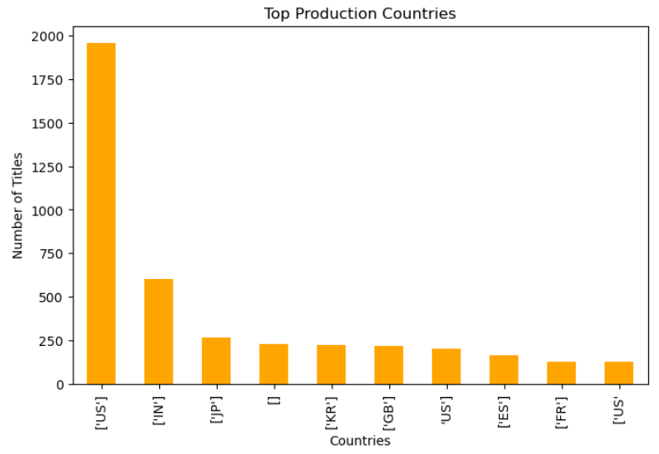
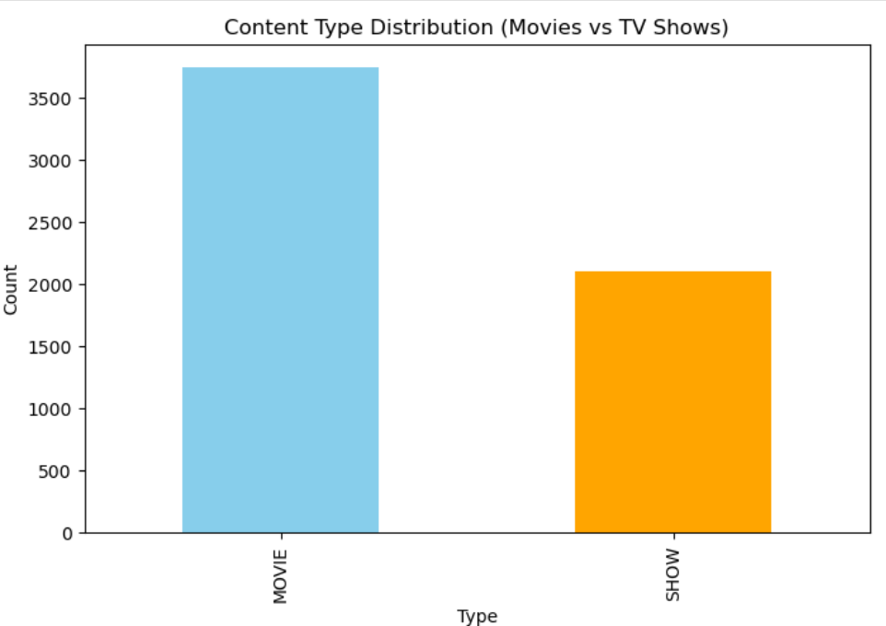

Slide 9
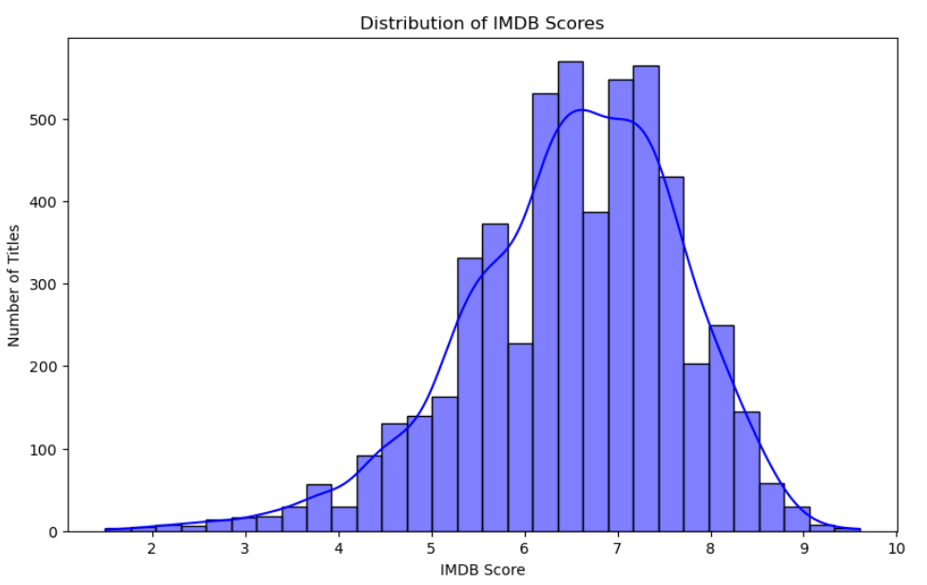

Slide 10
import numpy as np
import pandas as pd
from matplotlib import pyplot as plt
import seaborn as sns
import plotly.express as px
from sklearn.model_selection
import train_test_splitfrom sklearn.linear_model
import LinearRegression, LogisticRegressionfrom sklearn.metrics
import mean_absolute_error, accuracy_score, mean_squared_error ,r2_score
from sklearn.preprocessing import StandardScalerfrom scipy
import statsimport statsmodels.api as sm
from scipy.stats import ttest_ind, chi2_contingency, pearsonr, f_oneway
from sklearn.feature_extraction.text import TfidfVectorizerfrom sklearn.metrics.pairwise import cosine_similarity

Slide 11
What I observed in the project?
Data Sparsity: User-movie interaction data is often sparse, as most users rate only a small subset of movies.
Cold Start Problem: Difficulty recommending movies for new users or those with few ratings.
User Behavior Patterns: Users tend to have preferences for specific genres, actors, or directors, influencing their ratings.
Popularity Bias: Highly rated or frequently watched movies are over-represented in recommendations.
Collaborative Filtering Efficiency: User-based collaborative filtering works well but struggles with scalability for large datasets.
Content-Based Filtering Dependence: Relies heavily on detailed metadata, which may not always capture user preferences effectively.
Hybrid Models: Combining collaborative and content-based filtering improves accuracy and mitigates cold-start challenges.
Performance Metrics: Evaluation metrics such as RMSE, Precision@K, and Recall@K help measure the system’s success.
Algorithmic Enhancements: Techniques like matrix factorization (e.g., SVD, ALS) and neural networks boost recommendation quality.
User Engagement: Metrics like click-through rates and watch time reveal the effectiveness of the recommendations.

Slide 12
Conclusion:
A Netflix movies recommendation system thrives on understanding user preferences and utilizing diverse algorithms to enhance recommendations. While challenges like sparsity, cold starts, and popularity bias exist, hybrid models and advanced algorithms can significantly improve accuracy and user engagement. Continuous feedback and metric evaluation are essential for refining the system to provide a personalized and satisfying user experience.

Slide 13
THANK YOU

